Slide 1

Fullhurst Community College presents…
Putting students first

Slide 2

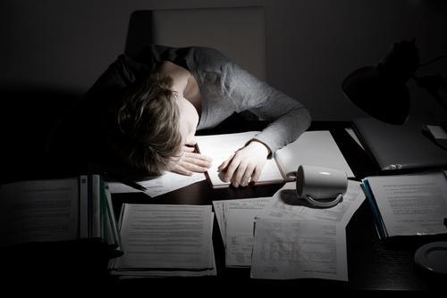
Problem:
Students pulling all-nighters in the library.
Stressed out staff working all hours.

Slide 3


Solution:
We are here to offer you “Time”.
Speed, sustainability and students at the heart of our business.
USP: 24 hour access to food-quick snacks to full meals.

Slide 4
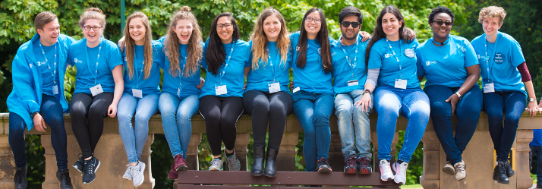
Market Research:
Shown that students are on campus between 8am and 7pm.
They often don’t have time to get a meal because its busy and not enough time between lectures.
Nothing available late at night when studying in the library.

Slide 5



What we offer:
50% off for opening week.
Breakfast pastries from 6am to 10:30 am.
From 10:30 onwards – Sandwiches, pasties, desserts and baked goods.
All including vegan, vegetarian and gluten-free/ dairy-free options.

Slide 6

Why should you invest?
24 hour service for staff and students.
Offers employment for students and local residents.
We’re putting students at the heart of our business.

Slide 7
Thank you for listening!
Any Questions?

